Slide 1



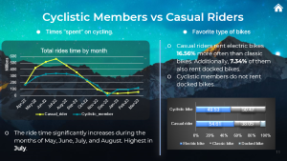
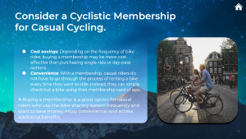
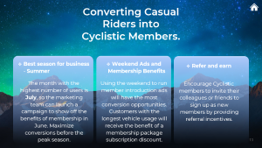
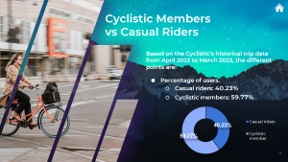
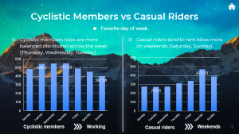
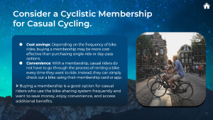
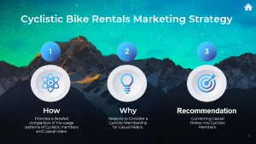

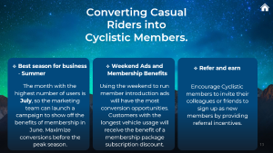
Cyclistic Bike Rentals Marketing Strategy
Analyzing customer behavior and trends can help create a targeted marketing strategy for bike rentals.

Slide 2
Cyclistic Bike Rentals Marketing Strategy
Analyzing customer behavior and trends can help create a targeted marketing strategy for bike rentals.

Slide 3
Cyclistic Bike Rentals Marketing Strategy
Analyzing customer behavior and trends can help create a targeted marketing strategy for bike rentals.

Slide 4
Cyclistic Bike Rentals Marketing Strategy
Analyzing customer behavior and trends can help create a targeted marketing strategy for bike rentals.

Slide 5
Cyclistic Bike Rentals Marketing Strategy
Analyzing customer behavior and trends can help create a targeted marketing strategy for bike rentals.

Slide 6
Cyclistic Bike Rentals Marketing Strategy
Analyzing customer behavior and trends can help create a targeted marketing strategy for bike rentals.

Slide 7
Cyclistic Bike Rentals Marketing Strategy
Analyzing customer behavior and trends can help create a targeted marketing strategy for bike rentals.

Slide 8

Cyclistic Bike Rentals Marketing Strategy
1
2
3
How
Why
Recommendation
Provides a detailed comparison of the usage patterns of Cyclistic members and Casual riders.
Reasons to Consider a Cyclistic Membership for Casual Riders.
Converting Casual Riders into Cyclistic Members.

Slide 9

Cyclistic Members vs Casual Riders
Based on the Cyclistic’s historical trip data
from April 2022 to March 2023, the different points are:
Percentage of users.
Casual riders: 40.23%
Cyclistic members: 59.77%

Slide 10

Cyclistic Members vs Casual Riders
Favorite day of week.
Cyclistic members rides are more balanced distributed across the week (Thursday, Wednesday, Tuesday).
Casual riders tend to rent bikes more on weekends (Saturday, Sunday).
Working
Weekends

Slide 11
Cyclistic Members vs Casual Riders
Times “spent” on cycling.
Favorite type of bikes
Casual riders rent electric bikes 16.56% more often than classic bikes. Additionally, 7.34% of them also rent docked bikes.
Cyclistic members do not rent docked bikes.
The ride time significantly increases during the months of May, June, July, and August. Highest in July.

Slide 12
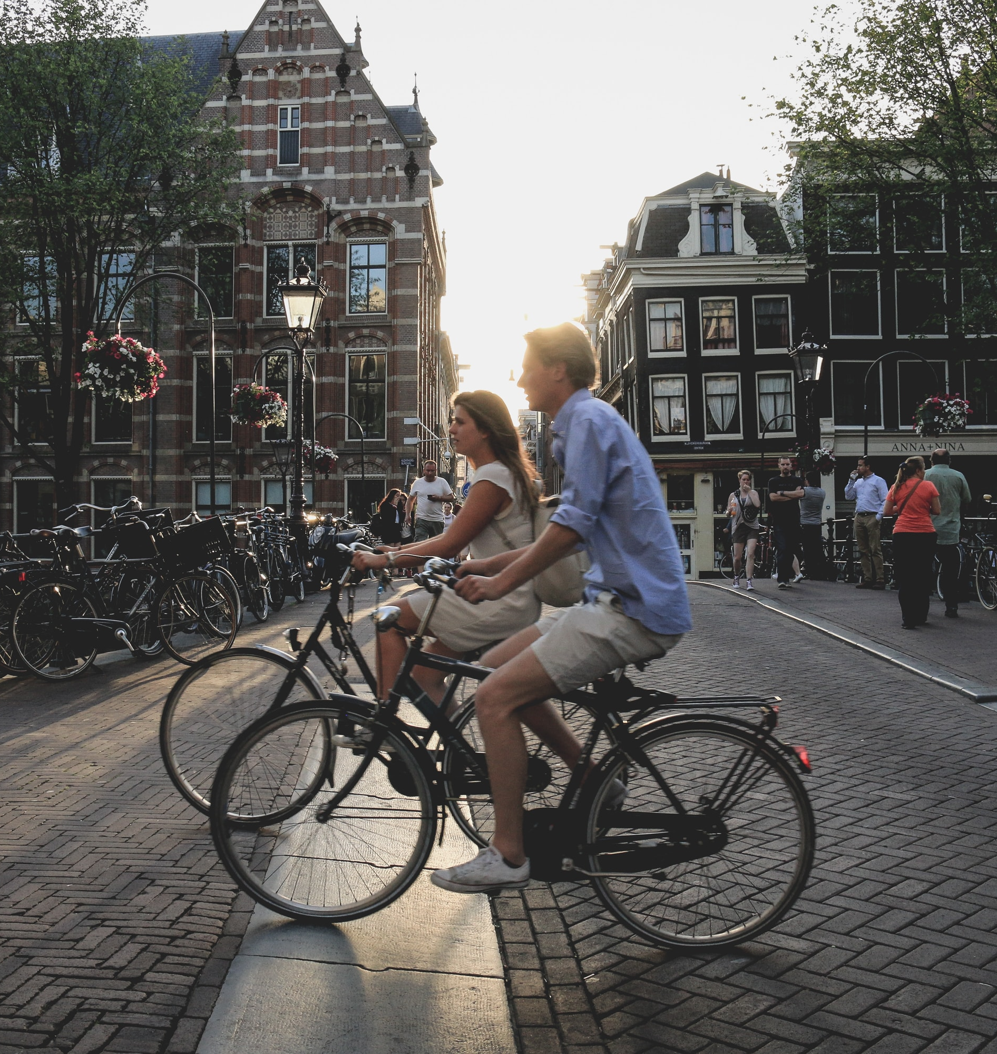
Consider a Cyclistic Membership for Casual Cycling.
Cost savings: Depending on the frequency of bike rides, buying a membership may be more cost-effective than purchasing single-ride or day-pass options.
Convenience: With a membership, casual riders do not have to go through the process of renting a bike every time they want to ride. Instead, they can simply check out a bike using their membership card or app.
➢ Buying a membership is a good option for casual riders who use the bike-sharing system frequently and want to save money, enjoy convenience, and access additional benefits.

Slide 13
Converting Casual Riders into Cyclistic Members.
Best season for business - Summer
The month with the highest number of users is July, so the marketing team can launch a campaign to show off the benefits of membership in June. Maximize conversions before the peak season.
Weekend Ads and Membership Benefits
Using the weekend to run member introduction ads will have the most conversion opportunities. Customers with the longest vehicle usage will receive the benefit of a membership package subscription discount.
Refer and earn
Encourage Cyclistic members to invite their colleagues or friends to sign up as new members by providing referral incentives.

Slide 14
Thank you!

